Slide 1
Using Adaptive Cards and Deep Links in Task Modules

Slide 2

Overview
Adaptive cards overview
Designing adaptive cards
Invoking task modules using Adaptive cards
Invoking task modules with deep links

Slide 3
Adaptive Cards
Notes:
In this section, we will explore Adaptive Cards

Slide 4
Adaptive Cards Overview
Card is a user-interface container for short / related pieces of information
Cards can have multiple properties, attachments and buttons that trigger Card actions
Adaptive cards are a cross product spec for cards in Microsoft products
Microsoft Teams recommends using Adaptive cards for new projects
Simplify creation of UX – focus on the content & functionality, let Teams render it
Notes:
A card is a user-interface (UI) container for short or related pieces of information. Cards can have multiple properties and attachments and can include buttons that can trigger Card actions.
Adaptive Cards are a cross-product specification for various Microsoft products including Bots, Outlook, Teams, and Windows. They're the recommended card type for new Microsoft Teams apps. Microsoft Teams supports multiple types of cards.

Slide 5
Developing Adaptive Cards for Microsoft Teams Task Modules

Slide 6
Adaptive Cards as JSON objects
Adaptive cards are represented as a JSON object
JSON defines the controls, text and actions to the hosting application
Hosting application renders the card based on the JSON
Creating the JSON for Adaptive Cards:
Author raw JSON
Create using Microsoft Teams SDK
Create & preview using App Studio
Notes:
An Adaptive Card is represented as a JSON object. The JSON string defines all the controls, text, and actions that the hosting application will use to render the card.
This JSON can be authored in any text editor. The Microsoft Teams app, App Studio, can be used to author Adaptive Cards starting with a template as well as preview the rendering of the card.

Slide 7
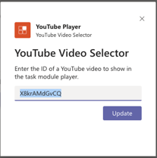
Adaptive Card JSON
{ "type": "AdaptiveCard", "version": "1.0",
"body": [{
"type": "Container",
"items": [{ "type": "TextBlock", "text": "YouTube Video Selector", "weight": "bolder", "size": "extraLarge” }]
},{
"type": "Container",
"items": [
{"type": "TextBlock", "text": "Enter the ID of...", "wrap": true},
{"type": "Input.Text", "id": "youTubeVideoId", "value": ”” }
]
}],
"actions": [{
"type": "Action.Submit", "title": "Update"
}]
}

Slide 8
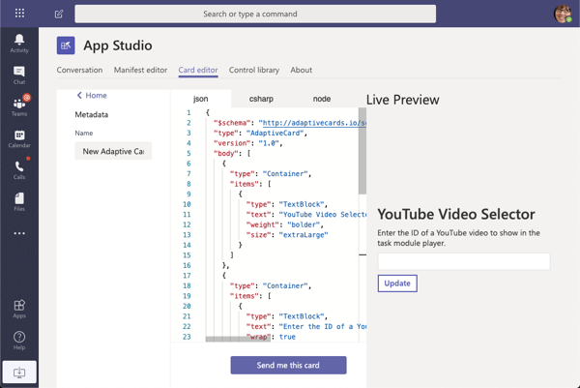
Creating Adaptive Cards with App Studio

Slide 9
Using Adaptive Cards with Task Modules
Using Adaptive cards with task modules is similar to using web pages
Task module web pages require setting the the url of the web page
To use an Adaptive cards the card JSON to the card property on the TaskModuleTaskInfo object
Notes:
Using Adaptive Cards in task modules follows almost all the same rules as a HTML-based task module.
One difference is how you create the task module. If you recall, a task module is invoked by passing a populated instance of the `taskInfo` object in the `microsoftTeams.tasks.startTask()` method. For an HTML-based task module, you set the address of the web page loaded in the task module in the `taskInfo.url` property.
When using an Adaptive Card, you assign the JSON of the card to the `taskInfo.card` property.
The other difference with Adaptive Cards is in the parameter of the callback method defined when invoking the task module with the `startTask()` method. The values of all input controls defined in the Adaptive Card are returned in a single object, `result`, in the callback method.

Slide 10
Using Adaptive Cards with Task Modules
// load adaptive card
const adaptiveCard: any = require("./YouTubeSelectorCard.json");
const taskModuleInfo = {
title: "YouTube Video Selector",
card: adaptiveCard,
width: 350,
height: 250
};
const submitHandler = (err: string, result: any): void => { };
microsoftTeams.tasks.startTask(taskModuleInfo, submitHandler);

Slide 11
Invoke Task Modules using deep links
Notes:
In this section, we will explore how to invoke task modules with deep links

Slide 12
Invoke task modules with deep links
Task modules can be invoked from tabs, bots and via deep links
Deep link is a special URL that contains the TaskModuleTaskInfo object’s properties encoded in the query string
Can be used to invoke the task module from within Microsoft Teams (conversations, links in tabs, etc) or outside of Microsoft Teams
https://teams.microsoft.com/l/task/<APP_ID>?url=<TASKINFO.URL>&height=<TASKINFO.HEIGHT>&width=<TASKINFO.WIDTH>&title=<TASKINFO.TITLE>
Include the Microsoft Teams’ app’s unique ID in the URL, and all necessary properties for the task module project
Notes:
Task modules can be invoked using buttons and other types of user actions within Microsoft Teams. Another way to invoke a task module is with a deep link.
Deep links are URLs that contain specific values that Microsoft Teams uses to invoke the task module.
Let's look at each of these values:
- `<APP_ID>`: This is the ID of the custom Microsoft Teams app. The app ID, a GUID, can be found in the app's **manifest.json** file.
- `<TASKINFO.*>`: The additional properties in the query string of the URL map to specific properties on the `taskInfo` object covered in a previous unit.
The deep link can be used from anywhere, including the conversations within Microsoft Teams channels or in external applications.

Slide 13
Demo

Slide 14
Thank you.

